Slide 1
The Data Analytics Framework for XDMoD
Aaron Weeden¹, Joseph P. White¹, Robert L. DeLeon¹, Ryan Rathsam¹, Nikolay A. Simakov¹, Conner Saeli¹, Thomas R. Furlani²
¹ Center for Computational Research, University at Buffalo, Buffalo, NY
² Roswell Park Comprehensive Cancer Center, Buffalo, NY
Metrics2023
NSF Award: OCI 2137603

Slide 2
Introduction
The US National Science Foundation (NSF) invests in a cyberinfrastructure (CI) ecosystem
A major component of this is the Advanced Cyberinfrastructure Coordination Ecosystem: Services & Support (ACCESS) program
Comprehensive instrumentation, monitoring, measurement, and reporting of ACCESS are essential
The ACCESS Metrics team provides this service for ACCESS and other NSF programs, e.g., Campus Cyberinfrastructure (CC*) and Cyberinfrastructure for Sustained Scientific Innovation (CSSI)
Extension of successful Technology Audit Service (TAS) and XD Metrics Service (XMS) programs that monitored NSF Extreme Science and Engineering Discovery Environment (XSEDE)

Slide 3
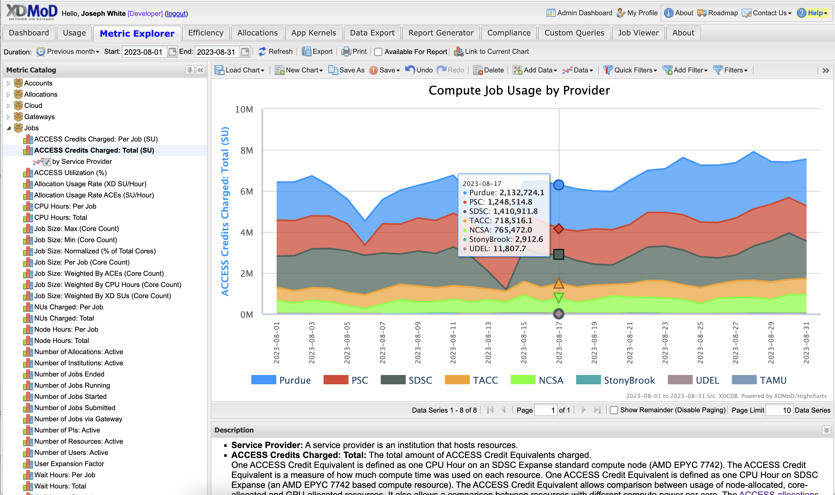
Open XDMoD
Software developed and used by ACCESS Metrics team
Web-based portal for data exploration, visualization, and export
Role-based views for various CI stakeholders
ACCESS XDMoD has historical usage data from NSF TeraGrid, XSEDE, and ACCESS programs
Open XDMoD also has 400+ known installations at CI centers

Slide 4
Motivation
Open XDMoD is a well-established tool, but limited
Charting is limited (e.g., no histograms, scatter plots, maps)
Existing Report Generator has limited customization options
Workload analyses benefit from data, but must circumvent portal and use external analysis tools
Customization of portal requires extensive knowledge of software and time to run data pipelines
Existing export capability is slow (daily batch job)

Slide 5
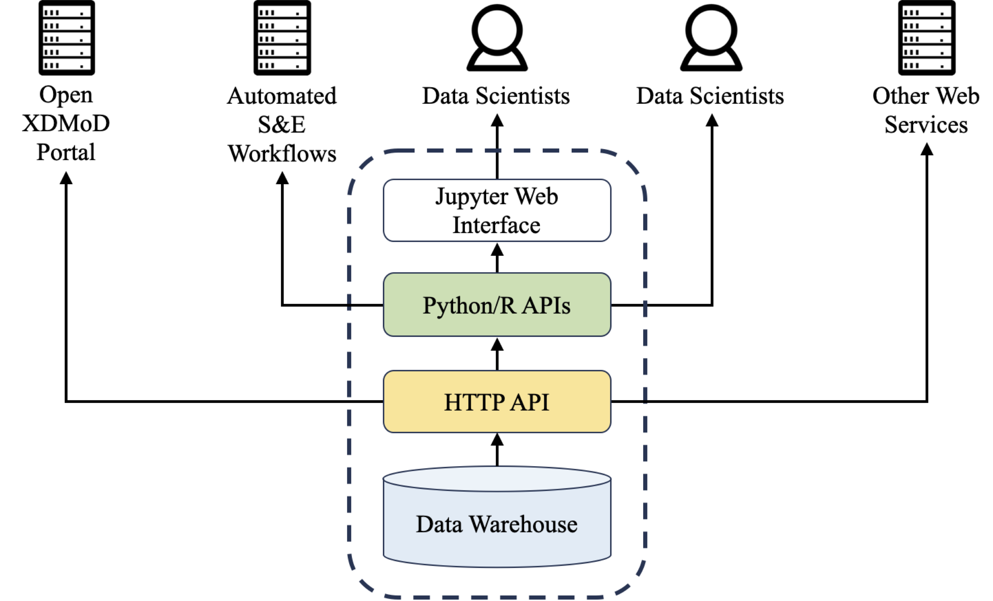
Design goals
Data Analytics Framework for programmatic access to data in Open XDMoD
Simple, documented, stable, versioned Application Program Interfaces (APIs) in HTTP, Python, and R
Jupyter notebooks for documentation, training materials, and templates for analysis and reporting

Slide 6
Python API
Request data, load into Pandas data frames
pip install xdmod-data
Consistent functionality and terminology with Open XDMoD portal
Version 1.0.0 released July 2023
Compatible with Open XDMoD ≥10.5.0
data = data_warehouse.get_data(
duration=('2023-01-01', '2023-04-30'),
realm='Jobs',
metric='CPU Hours: Total',
dimension='Field of Science',
filters={'Resource': 'Expanse GPU'},
dataset_type='timeseries',
aggregation_unit='Day'
)

Slide 7
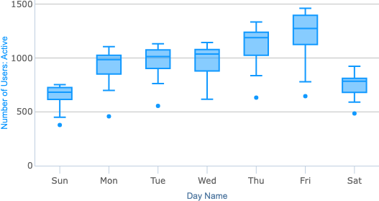
Example Jupyter notebooks
GitHub repository: https://github.com/ubccr/xdmod-notebooks
Instructions for running via Anaconda or Docker
Used in PEARC23 tutorial
XDMoD-Data-First-Example.ipynb:
Get data, make plots similar to what you can make in portal, make plots you cannot make in portal
XDMoD-Data-Raw-Data-Example.ipynb:
Get raw data, group, filter, and plot
XDMoD-Data-Machine-Learning-Example.ipynb:
Get raw data, run random forest regression model

Slide 8
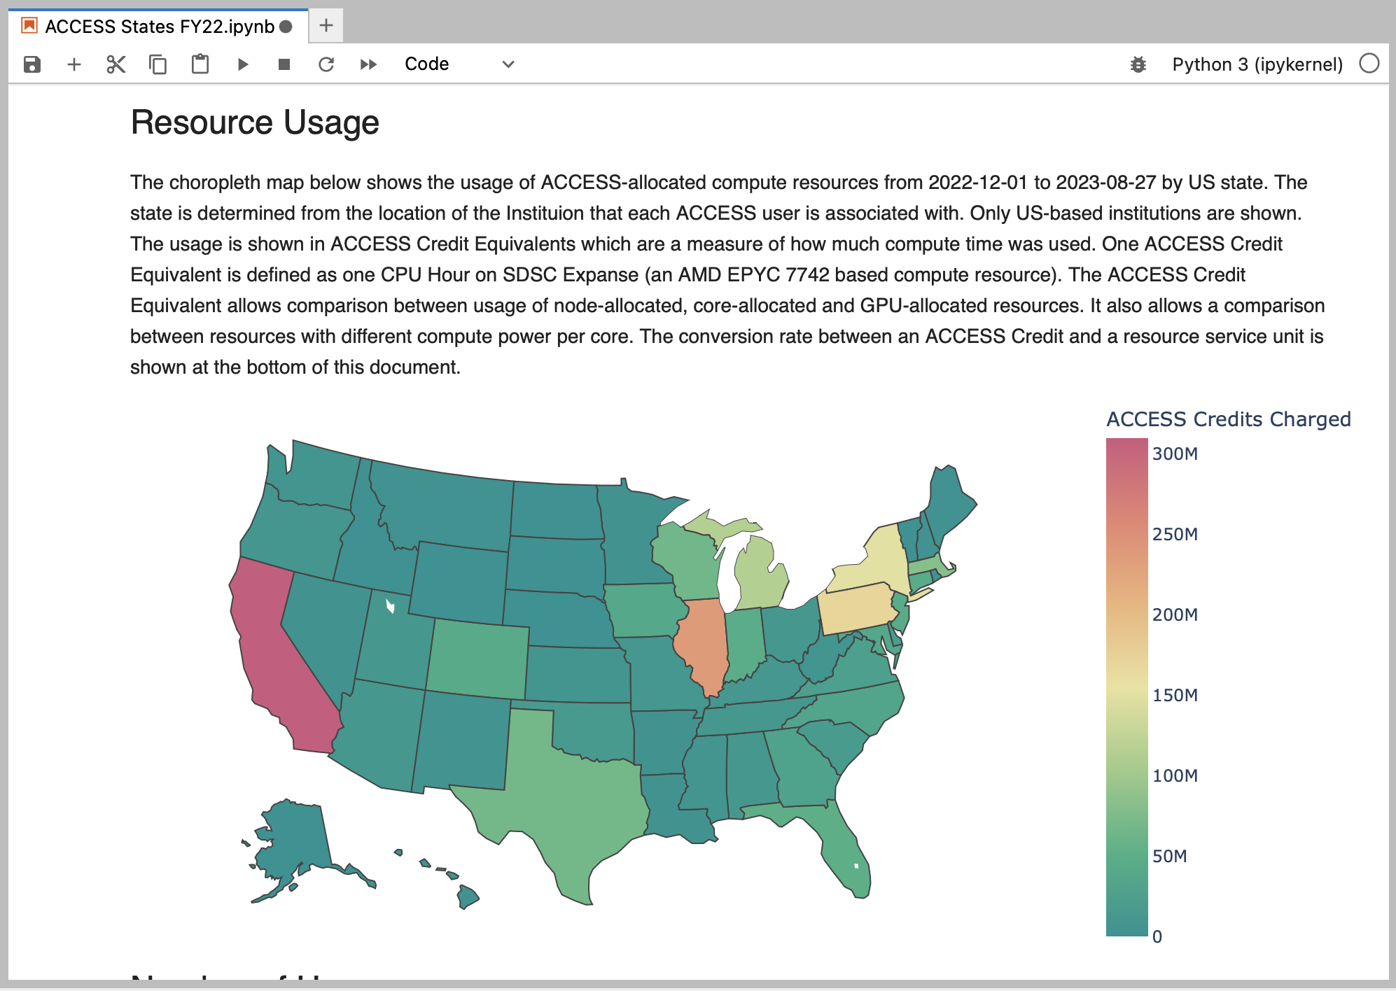
Case study #1
Usage of ACCESS-allocated resources by US state over nine-month period
Use Python API to fetch data from Jobs realm of ACCESS XDMoD
Metrics:
Number of ACCESS credits charged
Number of active users
Number of active institutions
Group by User State
Filter by User Country: United States
Join data from other sources
EPSCoR jurisdictions
State populations
Create Markdown tables and choropleth plots

Slide 9
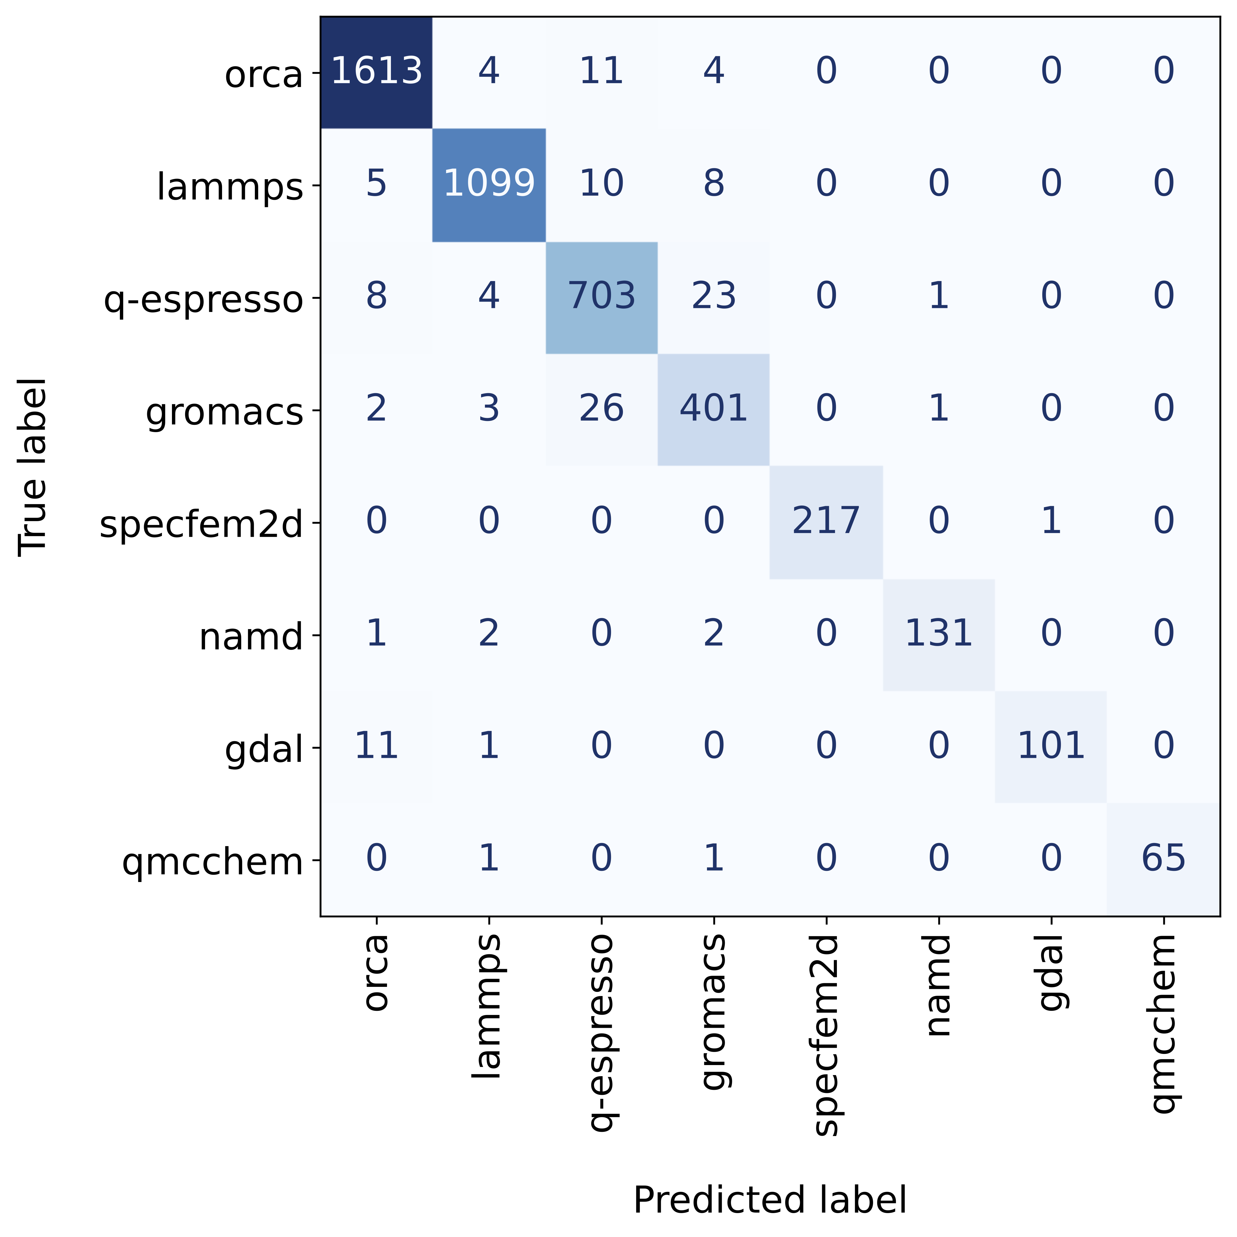
Case study #2
Confusion matrix
Machine learning random forest classification
Predict software application given characteristics of compute job
Use Python API to fetch raw data from Job Performance (SUPReMM) realm of ACCESS XDMoD
Predictors: CPU User, Wall Time, Total memory used, Net Ib0 Rx, Net Ib0 Tx, CPU User cov, Memory Used Cov, Net Ib0 Rx Cov, Net Ib0 Tx Cov
Filter top 8 applications over 2-month period
Use scikit-learn
40,134 training rows, 4,460 test rows
Out-of-bag accuracy: 97%

Slide 10
Future plans
Workload and utilization analyses
Regular software updates in tandem with Open XDMoD
Improved performance of retrieving raw data (esp. in the Jobs realm)
Improved consistency and simplicity of API
Improved options for filtering data
Improved R support
Hosted Jupyter notebooks (no need to install software)
Additional outreach

Slide 11
Contributions welcome
GitHub Pull Requests
Example Jupyter Notebooks: https://github.com/ubccr/xdmod-notebooks
xdmod-data Python API: https://github.com/ubccr/xdmod-data
Open XDMoD: https://github.com/ubccr/xdmod

Slide 12
Acknowledgements
This material is based upon work supported by the National Science Foundation under Grant No. OAC 2137603
Thanks to the rest of the ACCESS MMS team (Matthew D. Jones, Abani K. Patra, Gregary Dean, Andrew Stoltman, Joshua Furlani, Jennifer Schopf, Shava Smallen, Vipin Chaudhary, Zahra Rahmani, Stephen Harrell, and Matt Cawood) and the other ACCESS teams
Thanks to Nick Cruz for assistance with initial prototyping of the Python and Jupyter implementations

